Slide 1
Applications of Data Science in Various Industries
Healthcare
Finance Services
Retail and E-Commers
Manufacturing, Logistics, and Supply Chain
Insurance
- Ritu Salunke

Slide 2
Data Science in Healthcare
Data scientists work closely with healthcare professionals to improve diagnoses, treatments, and processes. For example, by combining natural language processing (NLP) with data from scientific texts, data scientists can train chatbots to answer basic patient questions. Data drawn from processes like scheduling appointments, filing insurance claims, and billing is analyze to increase value-based care, reduce costs, and reduce errors. Additional data science applications in healthcare include:
Clinical and Lab Reporting - Data scientists can efficiently speed up the processing of clinical and lab reports and utilize deep machine learning to yield additional diagnosis insights.
Examining Medical Images - Advanced data science methods have helped train machines to become more adept at analyzing and identifying anomalies in medical images such as MRIs, X-rays, and scans.
Informing Wearable Health Tech - Today’s health tech wearables monitor and treat diseases ranging from diabetes and epilepsy to cancer and strokes. Regardless of the device, healthcare professionals work with data scientists to analyze its data to improve patient outcomes.
Map Citizens’ Access to Health Services - As maps tracking the coronavirus pandemic proved, geographic information systems (GIS) can help healthcare workers plot the spread of a disease or identify populations most at risk. Data scientists can leverage data and GIS systems to determine the accessibility of public health services.

Slide 3

Data Science in Healthcare

Slide 4
Data Science in Financial Services
The financial services industry, an early adopter of data-informed decision making processes, requires an increasing number of data scientists. Rice OMCS student Keaton Parkinson works as a tax technology and transformation consultant with Ernst and Young.
we also have quantitative groups that focus on areas of tax with a lot of data. Dealing with this material can include cleaning large amounts of data, scraping large PDFs, storing the information in a database, or providing insights to clients,” said Parkinson.
Assessing Risk - In addition to its use in calculating the risk of a proposed investment or transaction, data science drives the logic that blocks a fraudulent charge or initiates a text message about an unusual purchase amount or location.
Managing Portfolios - Algorithms and data analysis help tailor investment portfolios to retain a client’s preferences and attain their goals while responding to a fluctuating market.
Calculating Customer Lifetime Value - For banks and their customers, some relationships are healthier than others. Data analysis can help predict the expected lifetime value of a customer, prompting special offers or other incentives to maximize profitability.
Improving Customer Experience with Natural Language Processing - Like healthcare and other service providers, the finance industry is deploying more data-driven NLP chatbots to supply quick answers rather than put their clients on hold for the next available representative.

Slide 5
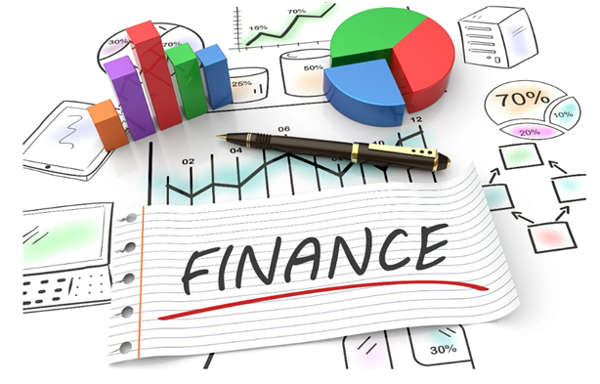
Data Science in Finance Services

Slide 6
Data Science in Retail and E-commerce
When it comes to selling consumer products, data science in retail and the e-commerce industry is used to help companies attract customers and avoid empty shelves or sluggish inventories.
Stocking Inventory to Match Supply and Demand - Balancing customer preferences with optimized pricing while maintaining an adequate inventory is a challenge best met with big data.
Analyzing the global and local availability of raw materials and other resources, tracking statistics to reveal current supply chain issues, and monitoring customer purchasing behavior can help a company achieve their inventory and distribution goals.
Recommendation Systems - Shopping sites and services use algorithms and machine learning tools like NLP and data visualization to predict trends and refine the prompts in their recommendation systems to match customer interests and purchases.

Slide 7
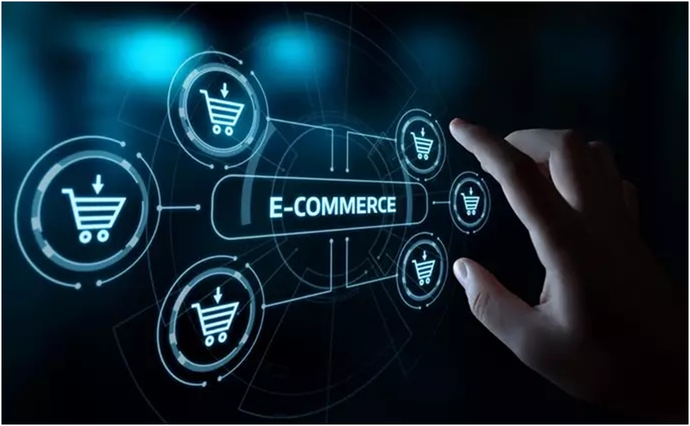
Data Science in Retail and E-commerce

Slide 8
Data Science in Manufacturing, Logistics, and Supply Chain
Digital transformation for companies in the manufacturing industry has prompted the Fourth Industrial Revolution , and the most successful Industry 4.0 leaders leverage not just IOT sensors and data science in manufacturing, but also artificial intelligence (AI) and a surge in autonomous robots and vehicles
Data scientists help their teams boost productivity by closely monitoring streams of data from all these sources to identify evolving trends in their business.
Closely linked with manufacturing, companies that manage logistics and various aspects of the supply chain are also dependent on data science applications.
Improving Production and Distribution Efficiencies - The use of data science tools like ML and predictive algorithms can speed up production time, avoid processing delays, and schedule preventative maintenance.
Data science is also used in quality assurance, storage and packaging efficiencies, and supply chain logistics.

Slide 9

Data Science in Manufacturing, Logistics, and Supply Chain

Slide 10
Data Science in Insurance
Insurers depend on the analyses of both actuaries and data scientists to remain in business.
One of the largest threats to insurers and their customers is the cost of fraudulent claims; paying for damage or a health procedure that never occurred reduces the amount of funds available for legitimate claims.
In addition to developing models to detect insurance fraud, data scientists also use ML and AI models to process simple claims, address membership questions, and identify marketing opportunities for customers celebrating life-time events like a new baby.
Predicting Claims - Insurers must not only respond to claims but also reevaluate the appropriate rate and coverage when an area is impacted by recurring crises like wildfires or flooding. Using previous customer and local data, historical comparisons for similar areas, and other risk management factors, data scientists can better predict the cost and profitability of revised insurance policies.
Personalizing Policy Options - Consumers celebrating events like a wedding, new car, or adoption may overlook the need for new or updated insurance coverage. To reach these potential clients, automated marketing tools shaped by data scientists can match products to changes in consumers’ lives, drawing attention to features and price options that resonate with other clients in similar market segments.

Slide 11
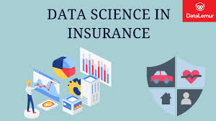
Data Science in Insurance

Slide 12
Thank You...

